Slide 1
Table of Content
What is Terraform.
How Does Terraform Work.
How to Use Terraform.
Provider in Terraform.
What Provider do in Terraform.
Terraform providers for Azure infrastructure.
Benefits of Terraform with Azure.

Slide 2
What is Terraform?
Terraform is an open-source Infrastructure as Code (IaC) tool created by HashiCorp. It enables users to define and provision infrastructure resources such as virtual machines, networks, storage, and more, using a declarative configuration language.
Terraform configurations are written in HashiCorp Configuration Language (HCL) or optionally JSON, and they describe the desired state of the infrastructure.

Slide 3
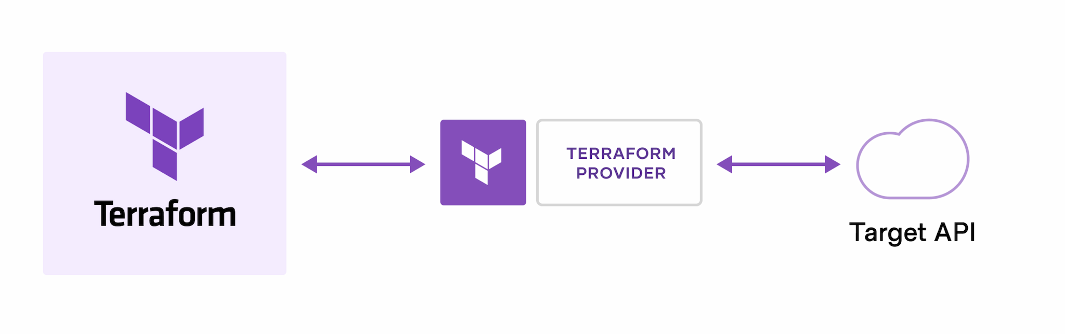
How Does Terraform Work?
Terraform creates and manages resources on cloud platforms and other services through their application programming interfaces (APIs). Providers enable Terraform to work with virtually any platform or service with an accessible API.
The core Terraform workflow consists of three stages:
Write: You define resources, which may be across multiple cloud providers and services.
For example, you might create a configuration to deploy an application on virtual machines in a Virtual Private Cloud (VPC) network with security groups and a load balancer.

Slide 4
Plan: Terraform creates an execution plan describing the infrastructure it will create, update, or destroy based on the existing infrastructure and your configuration.
Apply: On approval, Terraform performs the proposed operations in the correct order, respecting any resource dependencies.
For example, if you update the properties of a VPC and change the number of virtual machines in that VPC, Terraform will recreate the VPC before scaling the virtual machines.

Slide 5
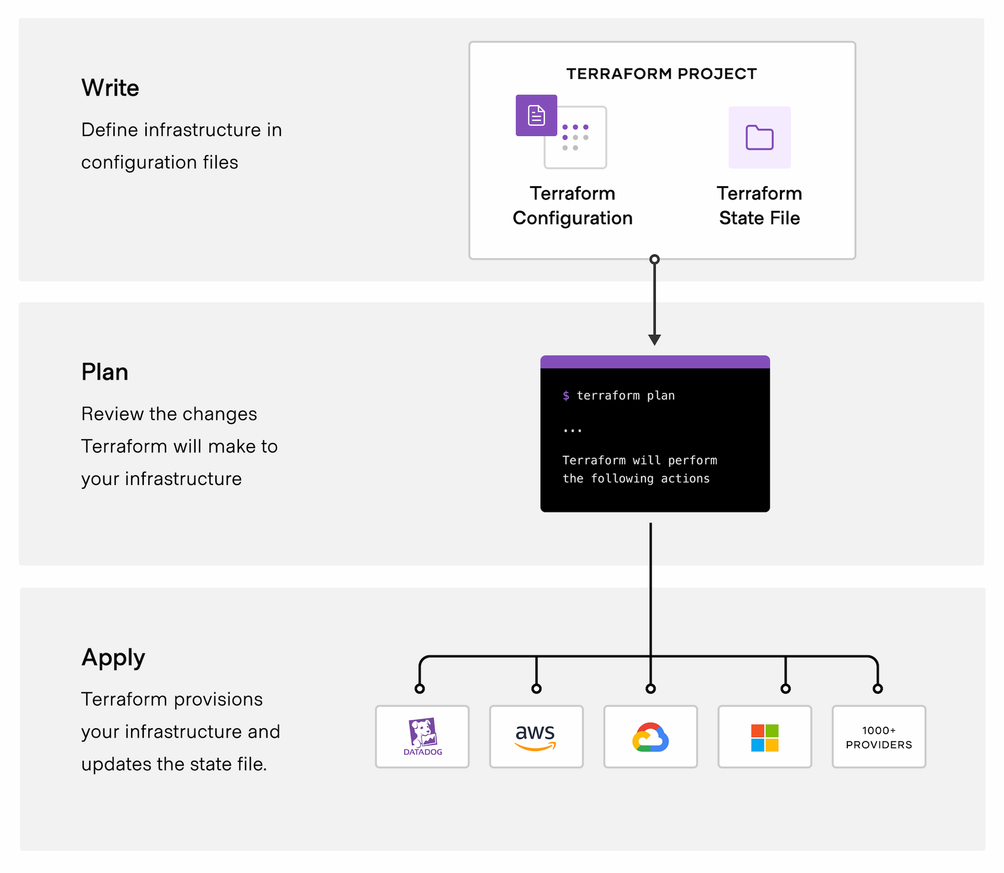

Slide 6
Why To Use Terraform
1. Automated Infrastructure Provision​
Terraform enables you to automate the provisioning and management of infrastructure resources. This saves time and reduces the likelihood of human error associated with manual provisioning processes.
2. Consistency and Version Control​
In the past, managing infrastructure configurations could lead to inconsistencies due to subtle differences introduced into the codebase.​
Terraform helps maintain consistent configurations across different environments by defining infrastructure as code.​
Version control ensures that changes are tracked and managed effectively.
3. Infrastructure as Code (IaC)
Terraform is part of the IaC movement, which aims to manage and provision infrastructure through code.​
Tools like Terraform, Ansible, CloudFormation, Chef, and Puppet emerged to support IaC, shaping modern DevOps practices.

Slide 7
4. Multi-Cloud and Hybrid Cloud Support
Terraform supports multiple cloud providers, including AWS, Azure, Google Cloud Platform, and others, as well as on-premises infrastructure. This allows you to manage resources across different cloud providers or hybrid cloud environments using a single tool.
5. Module Reusability​
Terraform offers modules, which are akin to functions or methods in programming languages.
Modules allow you to package and reuse common code, providing a standard interface for creating resources.

Slide 8
Provider In Terraform
Terraform relies on plugins called providers to interact with cloud providers, SaaS providers, and other APIs.
Terraform configurations must declare which providers they require so that Terraform can install and use them. Additionally, some providers require configuration (like endpoint URLs or cloud regions) before they can be used.
What Providers Do
Each provider adds a set of resource types and/or data sources that Terraform can manage.
Every resource type is implemented by a provider; without providers, Terraform can't manage any kind of infrastructure.
Most providers configure a specific infrastructure platform (either cloud or self-hosted). Providers can
also offer local utilities for tasks like generating random numbers for unique resource names.

Slide 9
Terraform providers for Azure infrastructure
AzureRM: Manage stable Azure resources and functionality such as virtual machines, storage accounts, and networking interfaces.
AzureAD: Manage Microsoft Entra resources such as groups, users, service principals, and applications.
AzureDevops: Manage Azure DevOps resources such as agents, repositories, projects, pipelines, and queries.
AzAPI: Manage Azure resources and functionality using the Azure Resource Manager APIs directly. This provider compliments the AzureRM provider by enabling the management of Azure resources that aren't released.
AzureStack: Manage Azure Stack Hub resources such as virtual machines, DNS, virtual networks, and storage.

Slide 10
Benefits of Terraform with Azure
Common IaC tool
Terraform Azure providers enable you to manage all of your Azure infrastructure using the same
declarative syntax and tooling. Using these providers you can:
Configure core platform capabilities such as management groups, policies, users, groups, and policies.
Configure Azure DevOps projects and pipelines to automate regular infrastructure and application deployments.
Deploy Azure resources required by your applications.
2. Scalability and Flexibility
Terraform supports the dynamic creation and scaling of Azure resources based on your application's needs. You can easily scale resources up or down, adjust configurations, and add new resources as required, ensuring your infrastructure remains agile and responsive.

Slide 11
3. Automate infrastructure management
The Terraform template-based configuration file syntax enables you to configure Azure resources in a repeatable and predictable manner. Automating infrastructure includes the following benefits:
Lowers the potential for human errors while deploying and managing infrastructure.
Deploys the same template multiple times to create identical development, test, and production environments.
Reduces the cost of development and test environments by creating them on-demand.
4. Integration with Azure Services
Terraform provides first-class support for a wide range of Azure services, including virtual machines, storage accounts, databases, networking components, and more. This enables you to leverage the full capabilities of Azure while managing your infrastructure with Terraform.

